Slide 1
Why settle for one MBSE tool when you can have an ecosystem?
Ulyana Tikhonova, Meinte Boersma,
Maarten Fekkers, Pedro J. Molina

Slide 2
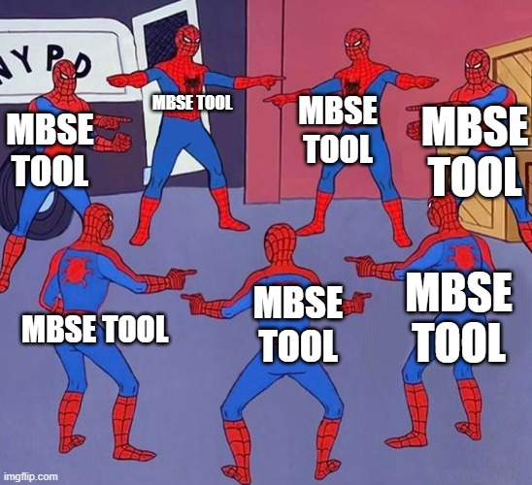
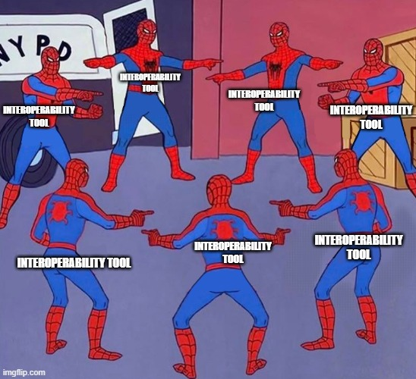
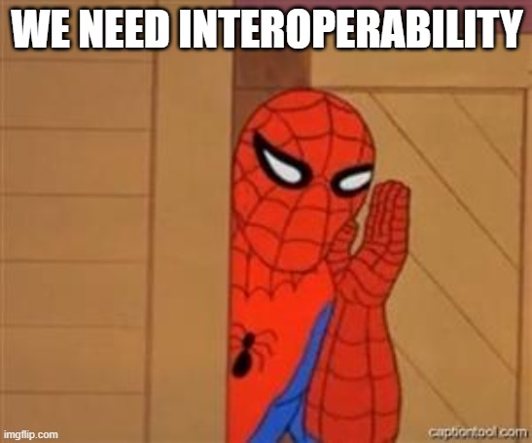
Notes:
A teaser!!

Slide 3
Challenges of interoperability
Universal vs. specific
Open vs. closed format
Semantic mapping
Possibility for customizations
Standard vs. tools
Identity of the transferred elements
Traceability
Merge conflicts

Slide 4
Model Driven Engineering &
Domain Specific Languages
Capture business knowledge
Use it as the single source of truth
Use jargon, conventions, and notations of the domain
Accessible for subject matter experts
Actionable/executable with interpreters and generators
Banking Insurance
Taxes Automotive Space Railway
Healthcare Cyber-physical systems Game development
Notes:
The world where we come from

Slide 5
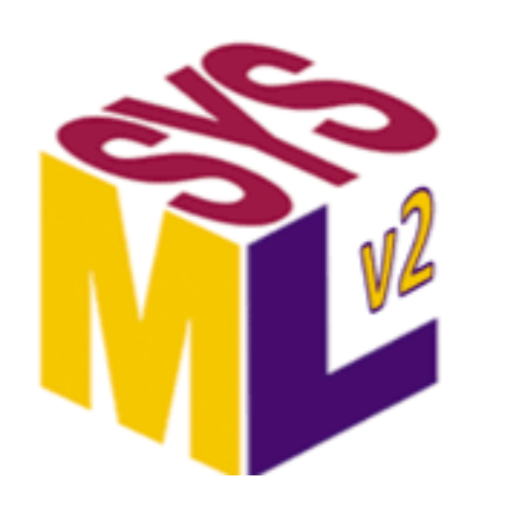
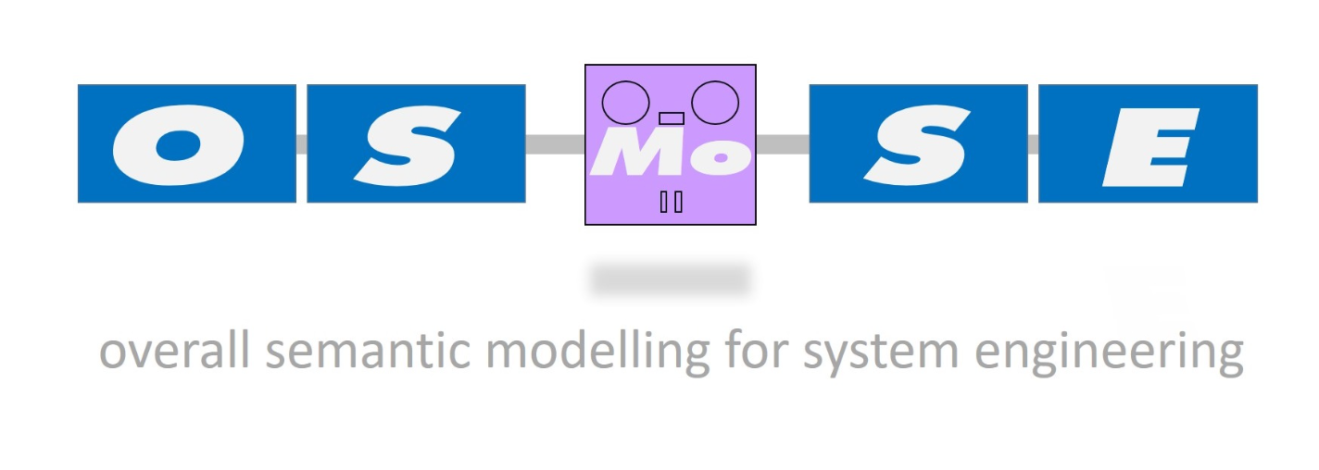




MBSE vs MDE & DSLs
Languages to capture the domain of System Engineering
Domain-Specific Extensions on top of them
MBSE tools to create, edit, and share models
Notes:
Let’s agree on the terminology, and see that we are not far from each other

Slide 6






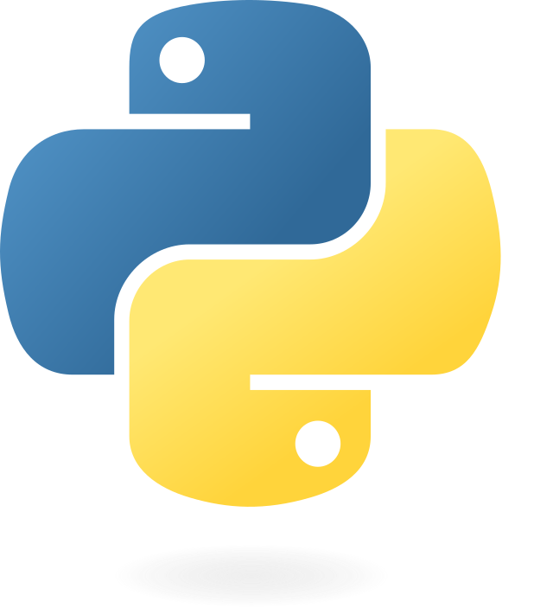
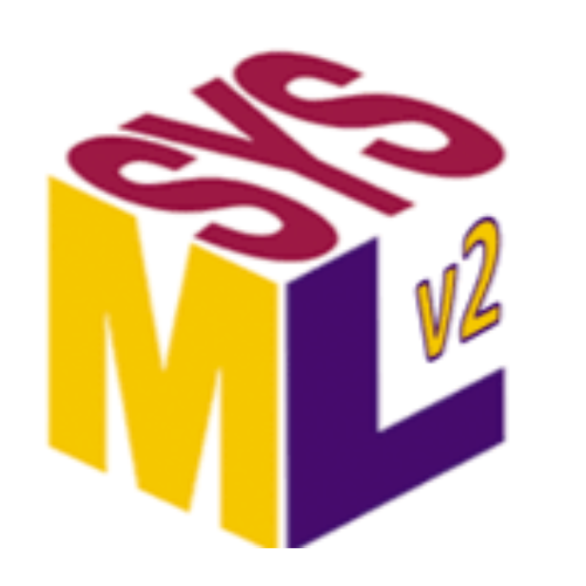



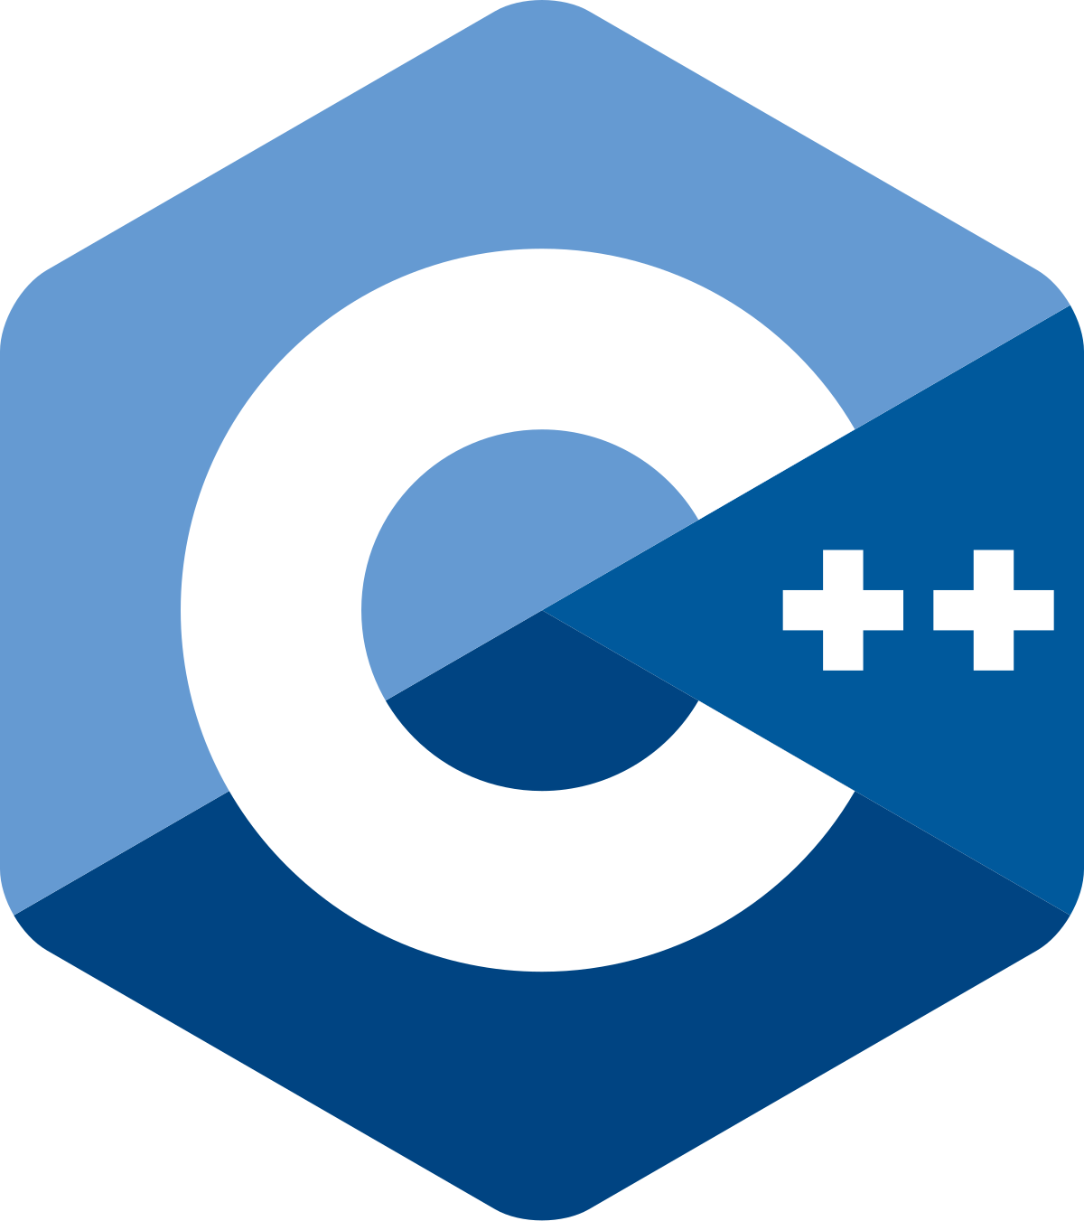
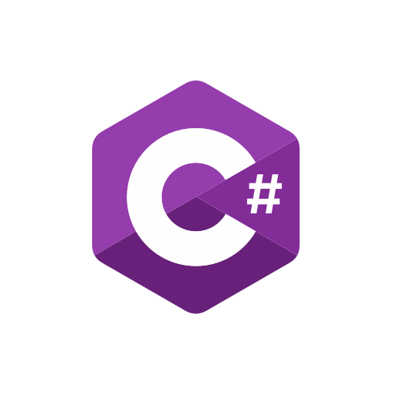

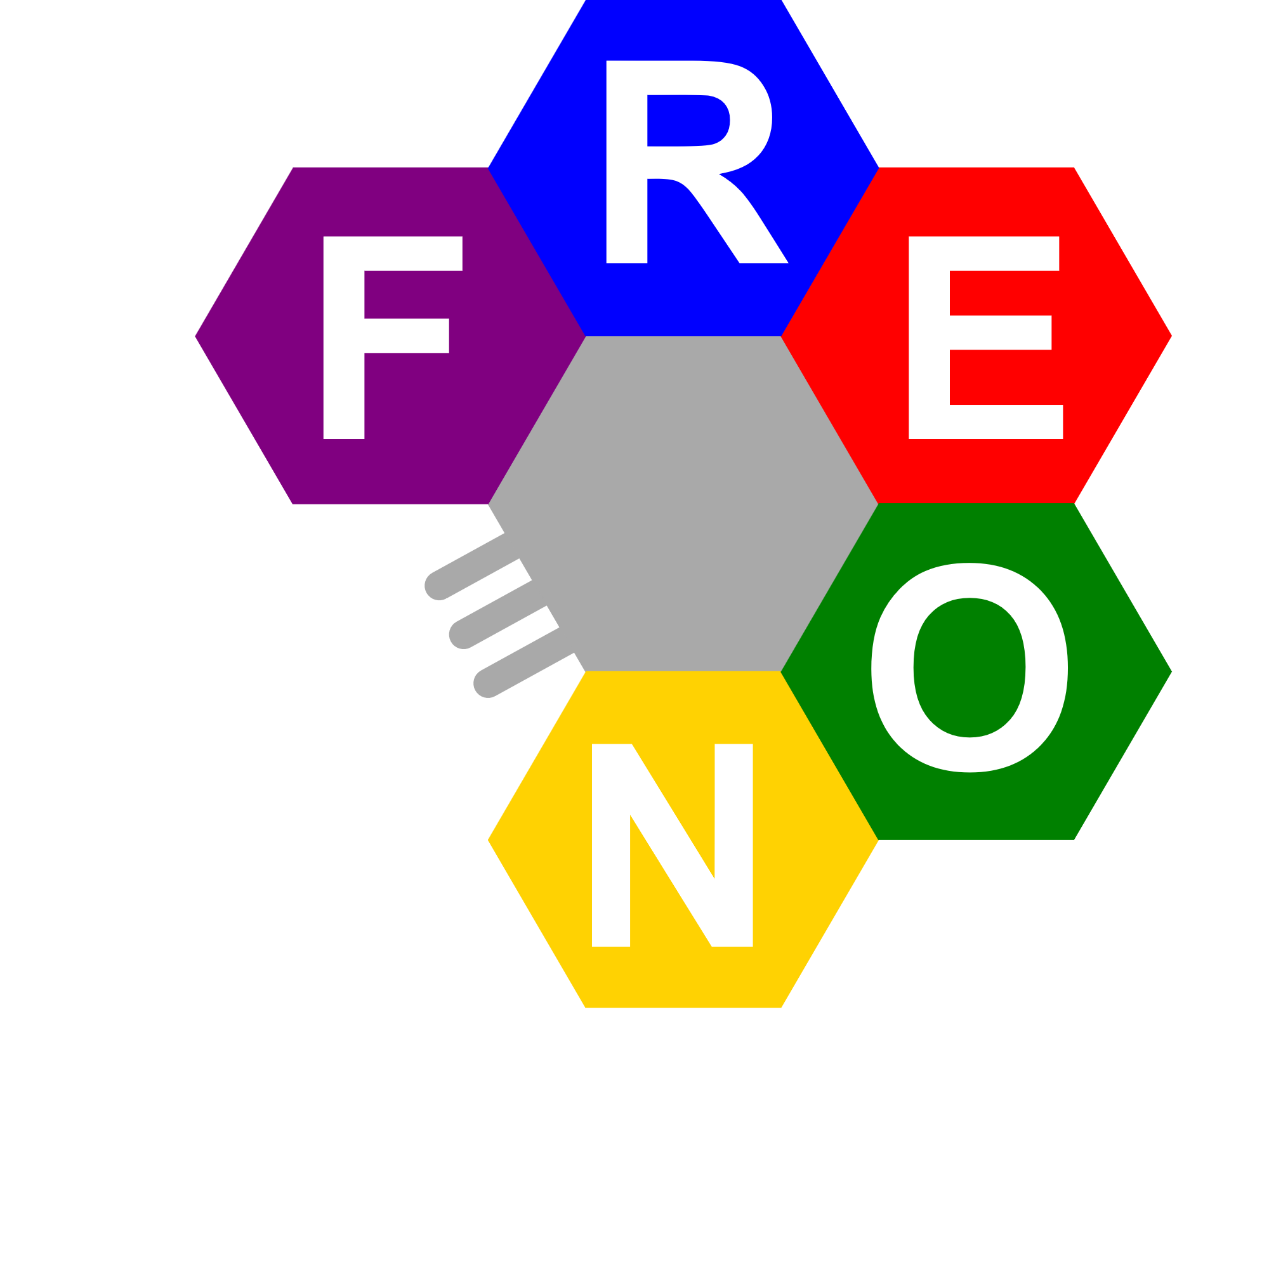

MBSE built with MDE tools
Notes:
Connection with MBSE:
MBSE tools are implemented in MDE tools as DSLs
There are even more MDE tools for your availability
And also, traditional SW implementation with well-known programming languages
Tools variety makes it difficult…
And it is not only about tools, as with each tool comes:
expertise on how to use it (+ the learning curve);
custom-made extensions for the tool;
Library of reusable components for generators/notations;
Strong tool lock-in
Many interesting tools/component that you would like to use … but you cannot
Everybody has to keep re-inventing the wheel
Language evolution.

Slide 7
We want to choose a tool that fits our project without having to restart from scratch

Slide 8
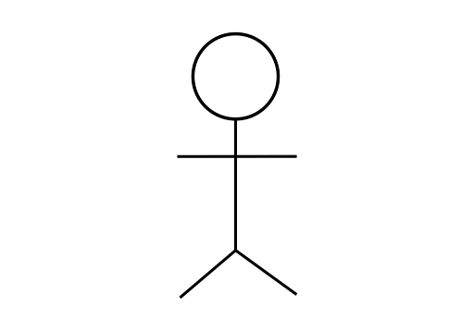

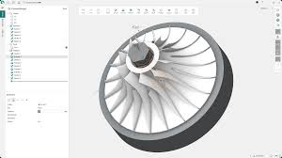
The real-world case
Customers use different software to work with their specific tools.
Language engineer
Software engineer
Designer
Operator
Notes:
In the same domain = using the same slang, concept understanding, and models
But working with the tools implemented using different technologies
Because each tool is tailored to its own user.

Slide 9
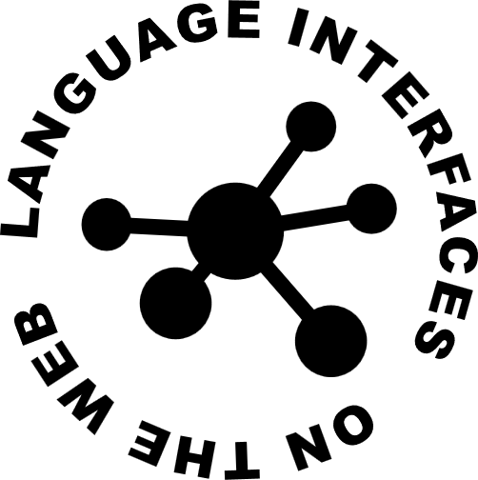
The real-world case
Customers use different software to work with their tools.
The next generation of software uses LionWeb to assure data consistency, reducing friction.
Languages and models

Slide 10

LionWeb: a protocol for exchanging languages and models
Notes:
What do we mean with interop?
Making information from other tool accessible
Deal with updates on all sides
No continuous manual effort

Slide 11
LionWeb architecture
Clients
Editors
Textual
Visual
Projectional
1
2
Processors
Model checker
Importer
Generator
Repository
Models
Original
Derived
Protocols (bulk / delta)
Contents (JSON)
Notes:
What: LionWeb as integration infrastructure
Turn Tool-to-tool n*m into Tool-to-Lionweb n + m
Explicitly designed for integration
No self-interest – not yet another tool
Making information from other tool accessible
Deal with updates on all sides
No continuous manual effort

Slide 12

Interoperability levels
MDE tool:
meta-meta-model
MDE tool:
meta-meta-model
M3
Language:
meta-model
Language:
meta-model
M2
Your DSL
M1
User models
User models
Notes:
Semantic integration, because of the interoperability of languages

Slide 13

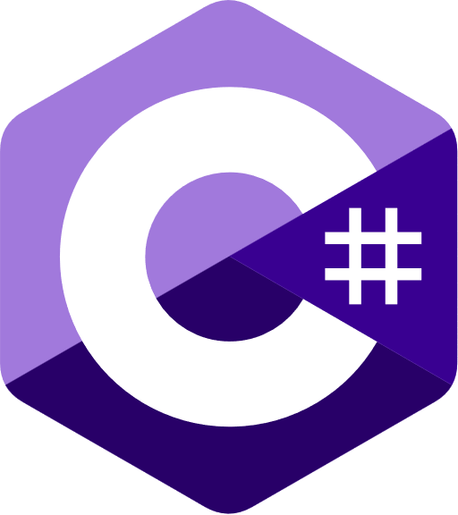
Demo
Demo 1
Demo 2

Slide 14
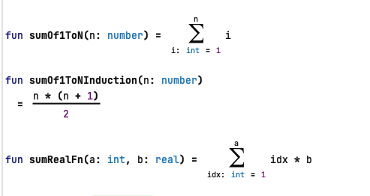
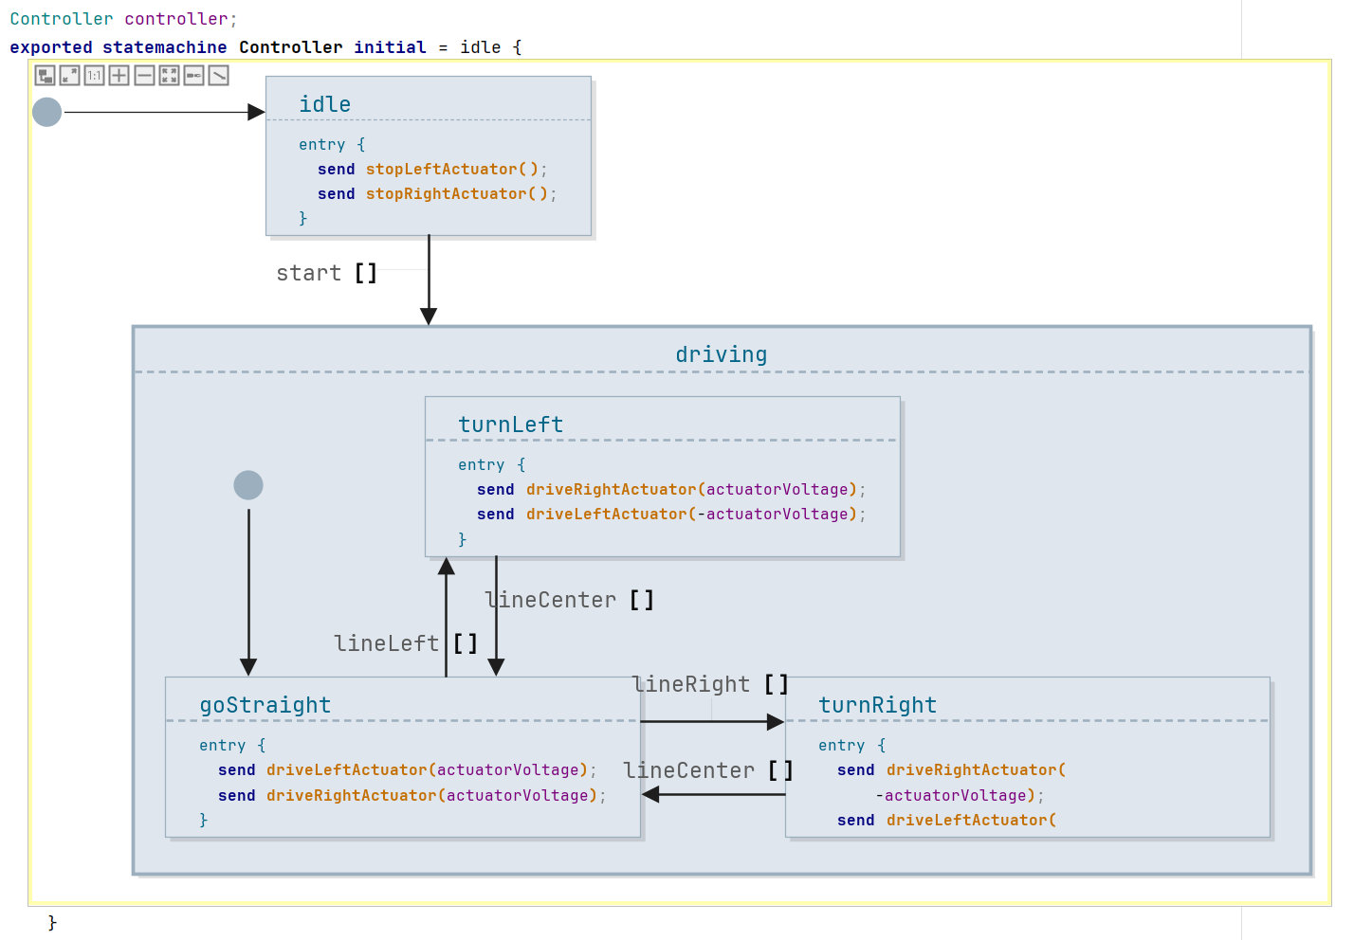
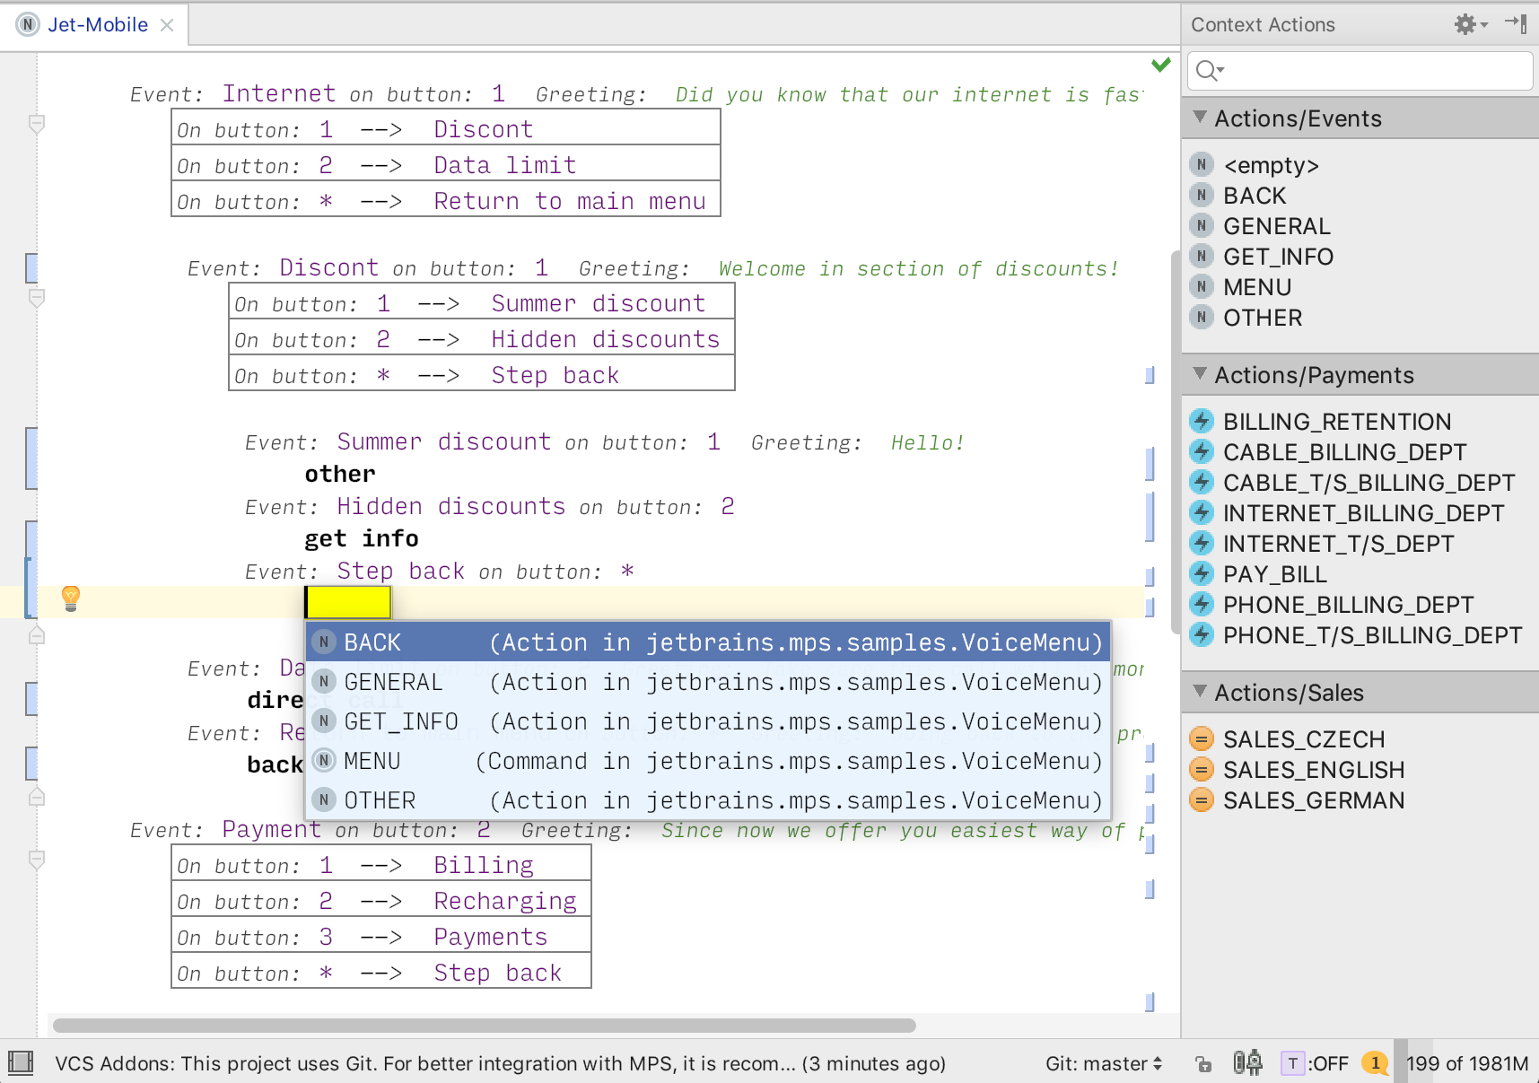
Demo 1
https://youtu.be/_RB0POoWLt0?si=_OzZEfTP25_pHwFo

Slide 15
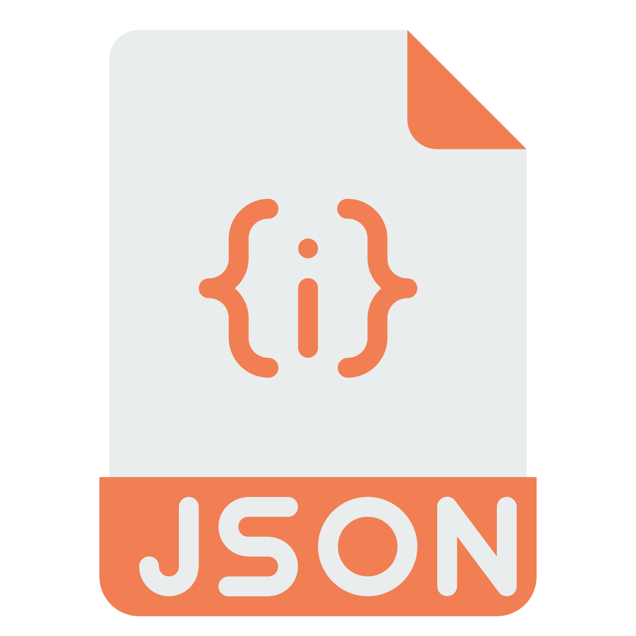
Demo 2
voyager1.instance.json
Repository
WebClient A
Loader
Validator
WebClient B
https://youtu.be/inN9l8gKxSc?si=XF6_wbB4cvAHq2HN

Slide 16
Our work on LionWeb
Apps
  Repository
  Repository admin UI
Integrations
  MPS
  Rascal
  Freon
  Modelix
  EMF
Libraries
  C#
  Java
  Kotlin
  Python
  TypeScript
Specification documents (public)
  Specification documents hosted on GitHub: github.com/LionWeb-io/specification
Notes:
Python Notebook interacting with the repository to: Access data, Modify data, Generate graphs, Calculate statistics
C# migration framework

Slide 17
How – Principles
International consortium of developers
  With a long history in language engineering and modeling tools
LionWeb as boring, reliable base
  Innovate on top
Rough consensus & Running code
  No paperware
Everything is a model
  Markus Voelter’s Whitepaper “A Platform for Systems and Business Modeling”
Business-friendly Open Source License
  Apache 2.0
Notes:
How
LW made for integration
Lots of experience
Everything is a model

Slide 18
Interested in Integration
Jetbrains WebMPS
Metadev Daga
ModelingValueGroup Dclare
TU Delft Spoofax
TypeFox Langium
  https://www.typefox.io/blog/lionweb-langium/
TypeFox Typir

Slide 19

What LionWeb solves
Technical interoperability
LionWeb format and protocols
Identity
established by clients (tools)
Semantic mapping
fine-grained and use-case specific
Notes:
LionWeb as integration infrastructure
Turn Tool-to-tool n*m into Tool-to-Lionweb n + m
Explicitly designed for integration
No self-interest – not yet another tool

Slide 20
Your feedback for us
Notes:
QR code for the quiz

Slide 21

Team and Contact
Team
Meinte Boersma DSL Consultancy
Erkan Diken F1RE
Norman Koester itemis (Modelix)
Sergej Koscejev Freelancer
Sascha Lisson itemis (Modelix)
Pedro Molina Metadev
Eugen Schindler Canon Production Printing
Alex Shatalin JetBrains (MPS)
Niko Stotz F1RE
Federico Tomassetti Strumenta
Markus Voelter Freelancer
Ulyana Tikhonova F1RE
Jos Warmer Freelancer (Freon)
Want to work with us: GitHub: Web:
info@lionweb.io https://github.com/LionWeb-io https://lionweb.io/
Slack to follow us, use, or implement LionWeb:
https://join.slack.com/t/lionweb/shared_invite/zt-2k1k5bsv7-EvC2IABIgSxWrqJNVOZ0HQ
Contact

